Slide 1
Today
1st of five “Climate Emergency Feedback Loops” videos (link)
Why gases are less soluble in warm water (link)
How the ocean->atmosphere feedback could be implemented in Cambio ("Level 1")
Talk about ideas for your projects

Slide 2
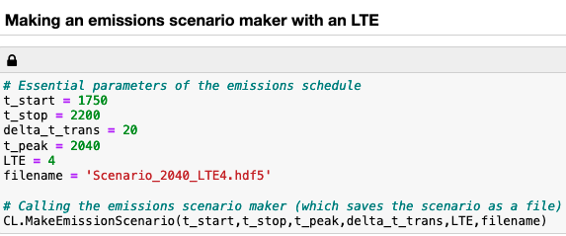
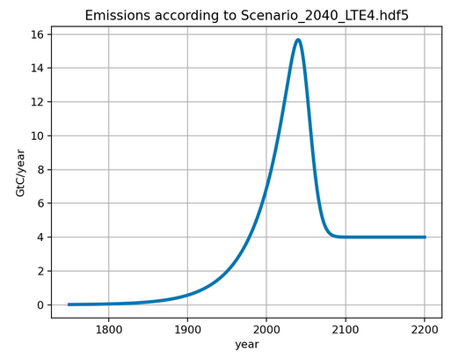
ScheduledFlowsLTE

Slide 3
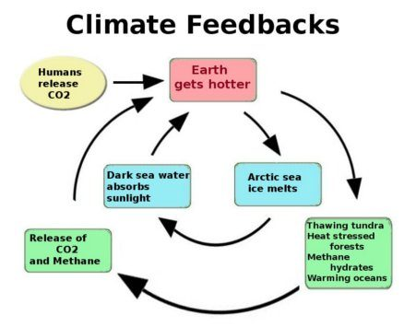
Cambio3.0
Level 1 has to do with the fact that the all gases (including CO₂) are less soluble in warmer water
Level 3
Level 2
Concentration CO₂ in the atmosphere goes up
Flux of CO₂ from water to air goes up
Level 1

Slide 4
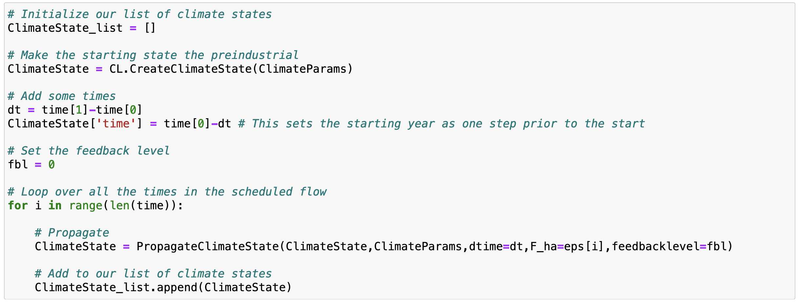
In the Euler loop of Cambio3.0, you tell PropagateClimateState what feedback level you want
fbl=0 says “no feedbacks”

Slide 5
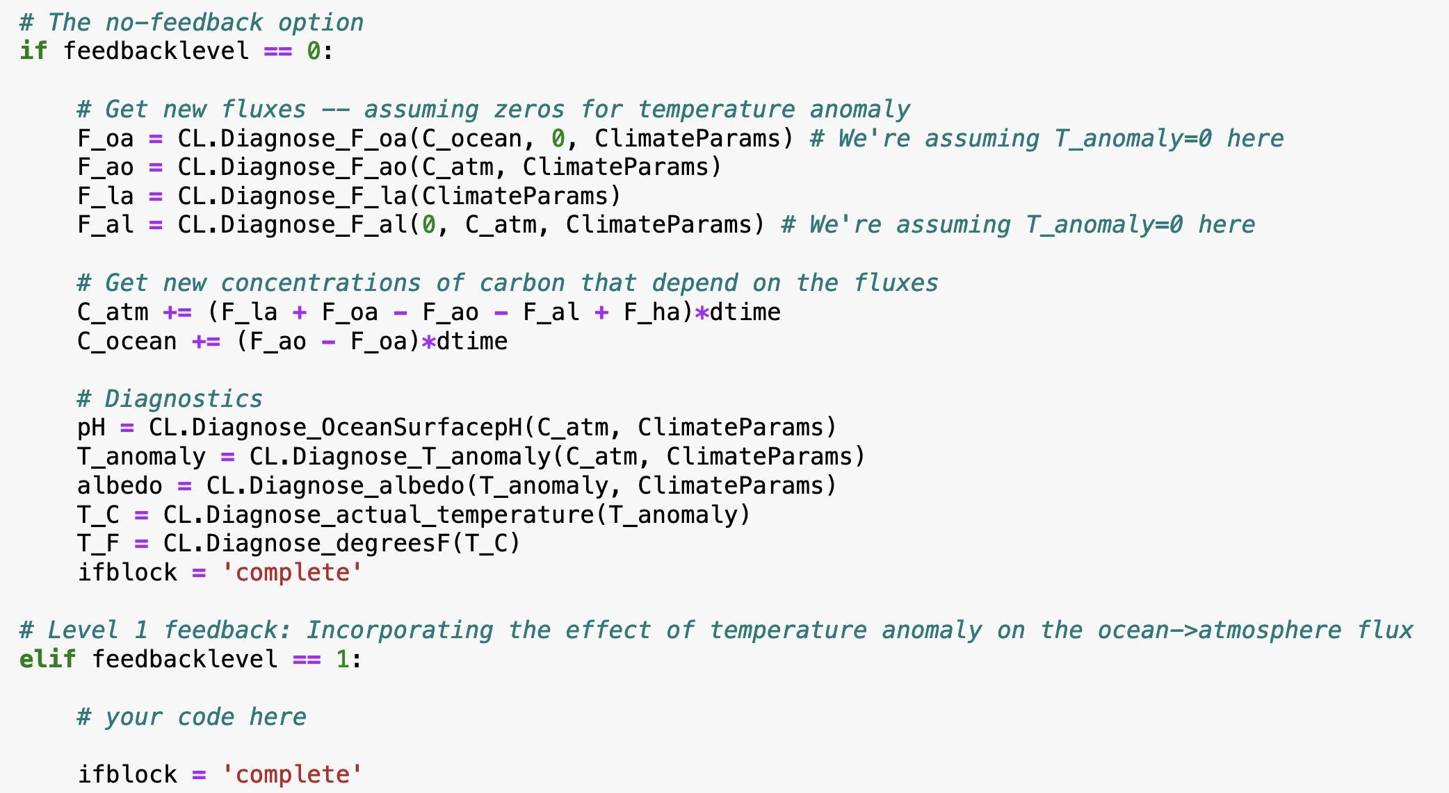
In PropagateClimateState, there are if-blocks that depend on the desired feedback level
Here’s the algorithm for Level 0

Slide 6
In PropagateClimateState, there are if-blocks that depend on the desired feedback level
Put the algorithm for Level 1 here … but what would that be?

Slide 7
Feedbacks we’ll consider this week
Level 1 has to do with the fact that the all gases (including CO₂) are less soluble in warmer water
Level 3
Level 2
Concentration CO₂ in the atmosphere (C_atm) goes up
Flux of CO₂ from water to air (F_oa) goes up
Level 1

Slide 8
In PropagateClimateState, there are if-blocks that depend on the desired feedback level
You’ll need to pass T_anomaly into to CL.Diagnose_F_oa, which means you’ll have to make the call to CL.Diagnose_T_anomaly earlier in the sequence.

Slide 9
Back in Euler, increase fbl to activate the corresponding feedback in PropagateClimateState

Slide 10
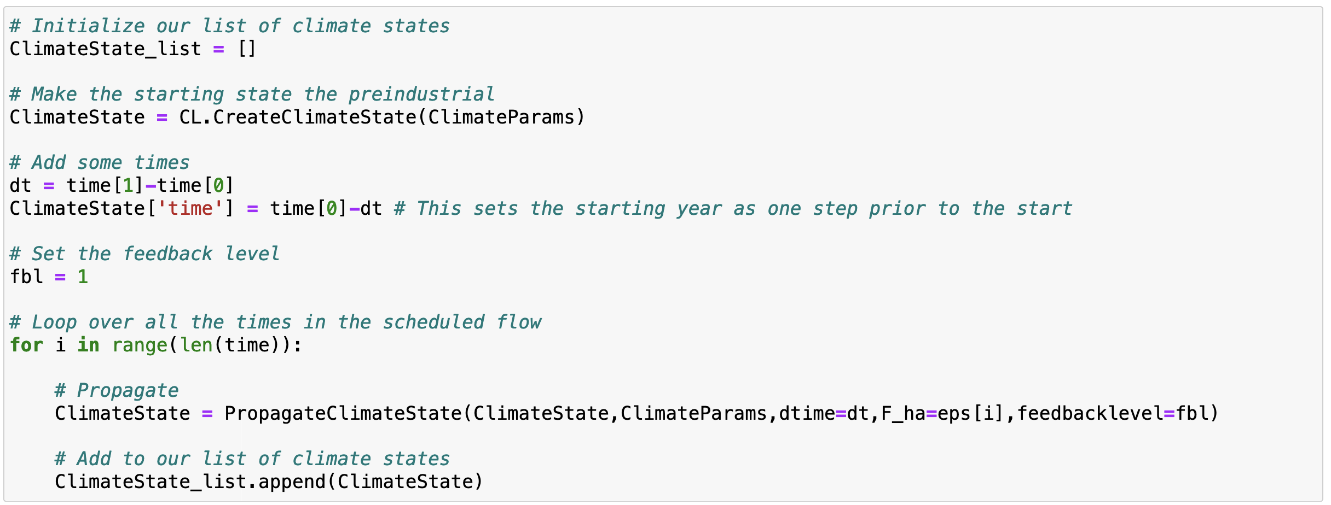
Back in Euler, increase fbl to activate the corresponding feedback in PropagateClimateState

Slide 11
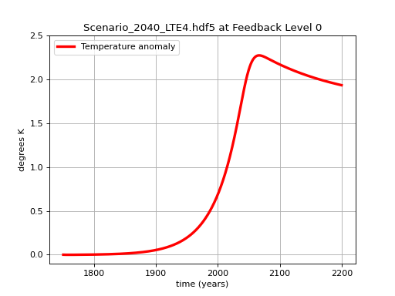
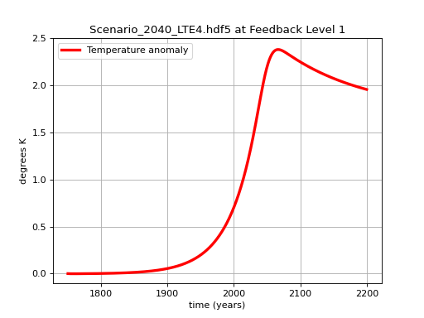
You’ll also want to document the changes

Slide 12
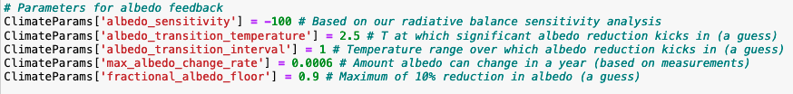
Ideas for your projects
Write a different ScheduledFlows generator.
Explore what happens w/different tipping points
Compare with other models (Monash, EnROADS, EzGCM)
Add a random element to carbon concentrations
Other

